Slide 1

Pattern Sense: Fabric Pattern Classification using Deep Learning
Using CNN Method

Slide 2
DATA SET OVERVIEW
Objective:
Build a CNN model to classify fabric images into pattern types.
Goals:
- Preprocess images
- Train custom CNN
- Evaluate on unseen data
- Enable real-time prediction

Slide 3

MODEL ARCHITECTURE
Model:
Custom CNN
Structure:
u- 3× (Conv2D → ReLU → MaxPool)
u- Flatten → Dense → ReLU → Dropout(0.5)
u- Output Layer (num_classes)
Configuration:
u- Loss: CrossEntropyLoss
u- Optimizer: Adam (lr=0.001)
u- MPS (Apple M1/M2)

Slide 4

TRAINING PROCESS
Hyperparameters:
u- Epochs: 10
u- Batch Size: 32
u- Image Size: 128×128
Steps:
u1. Forward Pass
u2. Loss & Backpropagation
u3. Optimizer Step
u4. Track Running Loss

Slide 5

EVALUATION & RESULTS
Metrics:
u- Precision, Recall, F1-Score (per class)
u- Confusion Matrix (true vs predicted)
Outcomes:
u- Identifies class performance
u- Highlights misclassifications

Slide 6
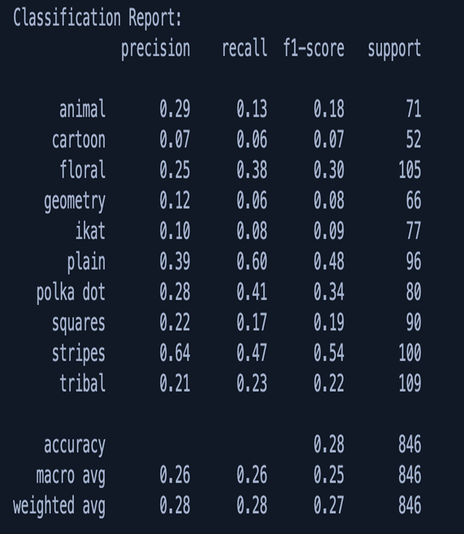
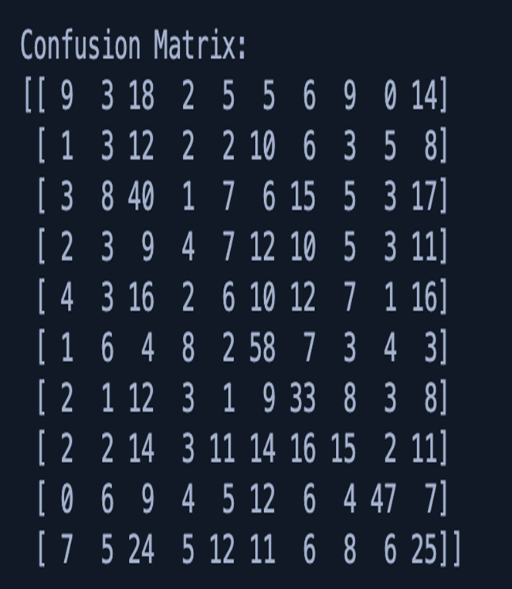
MODEL METRICS

Slide 7
THANK YOU

